Slide 1
HSBC Pepper (AI) – Oct 25
Agenda
Early Release
C.4 Case Study – AI & HSBC Pepper
Complete All Questions Today
Upcoming
Next Week: Programming

Slide 2
Early Release
P1: 8:40 – 9:20
P2: 9:20 – 10:00
P3: 10:00 – 10:40
P4: 10:40 – 11:20

Slide 3
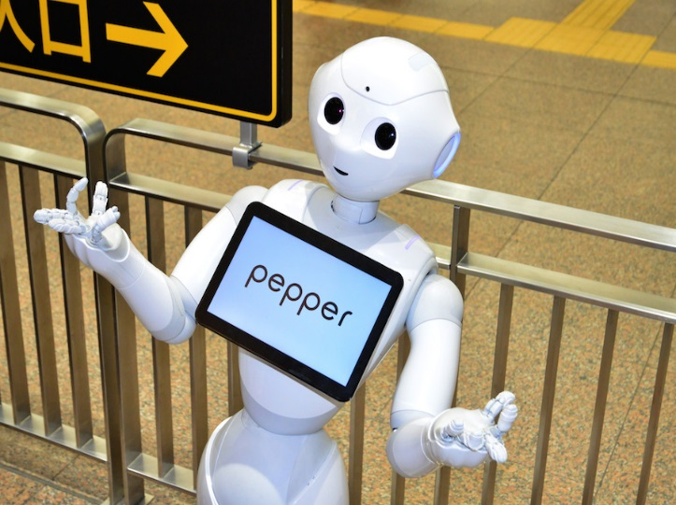
HSBC Pepper
AI – Artificial Intelligence
Not Just Robots
AI Takes Many Forms
AI Has Arrived!
AI Is Greatly Affecting Society TODAY
AI Will Affect YOUR Job Market TOMORROW

Slide 4
A.3 Brochure & Previous Work
Mrs. Manson @ Lunch (Starting Monday)
Sahil
Kunwar
Rajdeep
Devan
Apira
Yashmeen
Aiden
Jaskarandeep
Amadeous
Requirement:
Finish Student Questions
Finish Brochure
All submitted to GitHub

